Slide 1
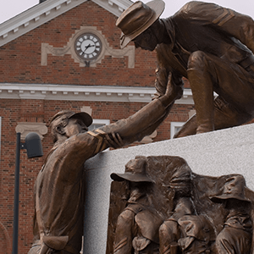
Lincoln Writing Center
Martin Luther King Hall
Room 117
Open Monday-Friday, 9am-5pm
For online help or to set up an appointment, email WritingCenter@LincolnU.edu
Project Specialist: Jaida Gray, GrayJ2@LincolnU.edu
Writing Center Director: Dr. Anna Perrigo, PerrigoA@lincolnu.edu

Slide 2
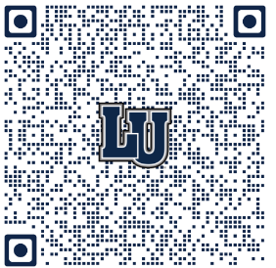
Make an appointment
Email WritingCenter@LincolnU.edu or scan the QR code
Making an appointment ensures you do not have to wait; there will be a tutor waiting for you
Walk-ins are always welcome!

Slide 3
What we offer
Writing support, whether you are brainstorming or polishing your final draft
We will look at any writing you have, including course assignments, essays, outlines, revisions, application essays and/or letters, personal statements, cover letters – or just about anything else that is written

Slide 4
What to bring
When visiting, students are encouraged to bring not only their own work, but anything else related to the assignment
This could be a prompt, a rubric, a reading, or whatever else
If any materials are online, you are welcome to use one of our computers to pull them up
If you would like to use our computers, please make sure to know your Lincoln login information

Slide 5
Our formatting
In-person appointments typically last about 30 minutes, but they can be longer or shorter depending on student needs
You may also submit work online by emailing WritingCenter@LincolnU.edu
Expect comments in 24-48 hours, Monday through Friday
You will not receive feedback online over the weekend, so get your work in early!
In your email, be sure to include documentation (including prompts, rubrics, etc.), a proper introduction, and any questions you’d like answered
We encourage students to come in person whenever possible. Face-to-face interactions facilitate connection and often lead to more productive conversations

Slide 6
What we don’t do
Discuss possible grades
We aren’t your professors! We do not know what grade you might get
Line edits
If you are only interested in discussing grammar, we can talk about that! However, we will not just correct your work – we’ll have a conversation
Take over
Your paper is your own. We respect that and encourage you to take your ownership over your work seriously

Slide 7
Who you will see
Peer tutors
Fellow Lincoln students who have been trained to respond to student questions and concerns in helpful and nonjudgemental ways
Jaida Gray
Jaida is our project manager, the supervisor of the day-to-day proceedings in the Writing Center, and a Lincoln alum

Slide 8
Contact information
Email WritingCenter@LincolnU.edu for an appointment
A reminder to expect online feedback in 24-48 hours, Monday-Friday
Come to Martin Luther King Hall 117 for a walk-in session
We are open 9am-5pm Monday-Friday
Questions?

