Slide 1
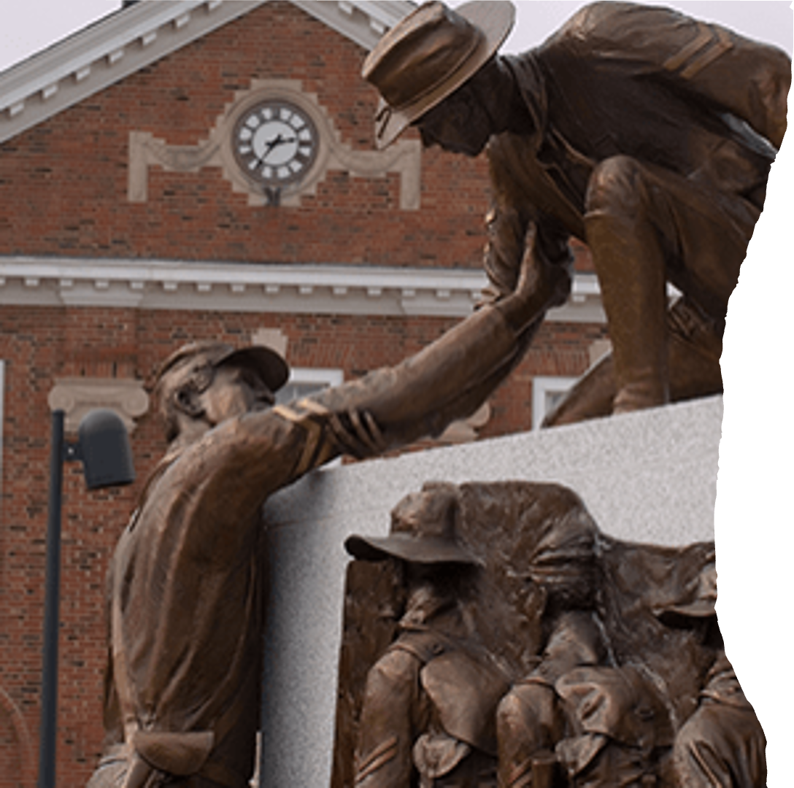

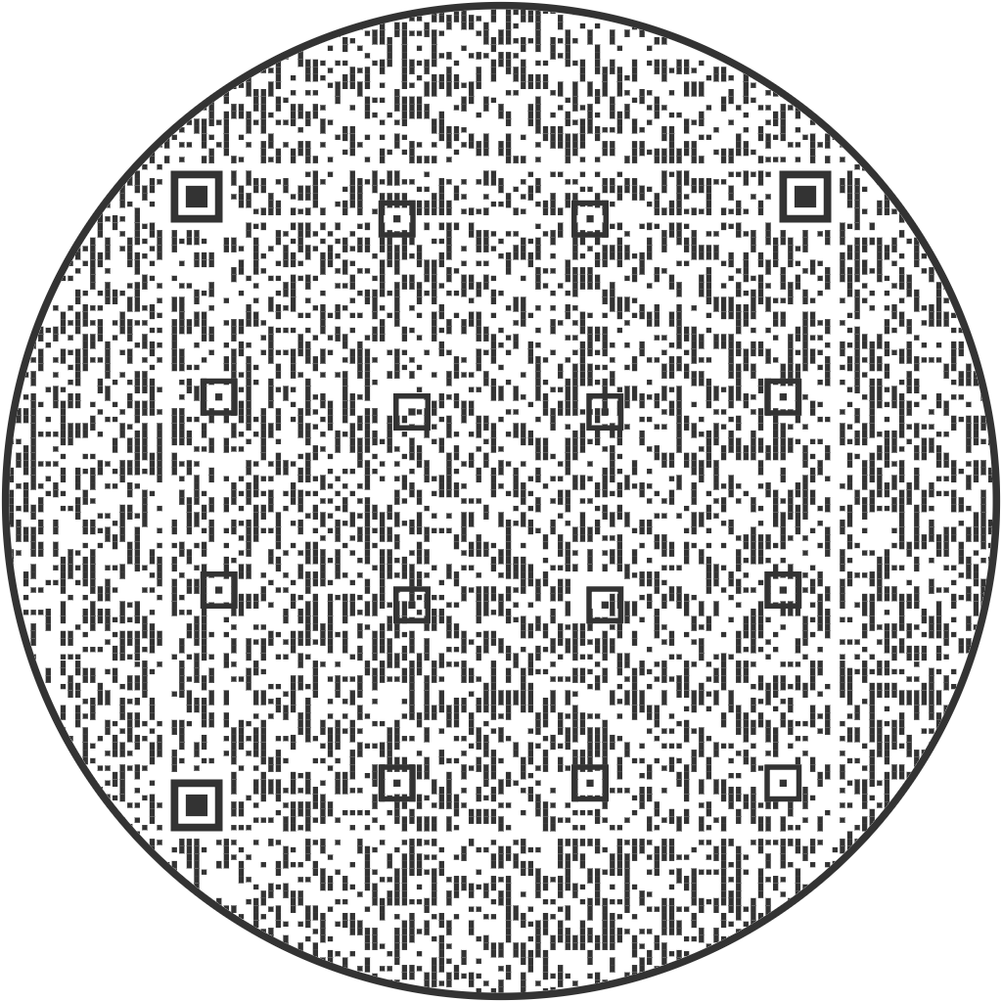
Writing Center
Martin Luther King Hall, 117
Monday-Friday, 9am-5pm
Project Specialist: Jules Duffin, DuffinJ@LincolnU.edu
Writing Center Director: Dr. Anna Perrigo, PerrigoA@lincolnu.edu

Slide 2

WHAT WE DO
  Writing Support
    From brainstorming to the final draft
  Help with ALL kinds of writing
    Course assignments and essays
    Initial outlines
    Final revisions
    Applications and cover letters
    Anything you write, we tutor!

Slide 3
01
Your current draft
Don’t have anything written yet? No worries! Our tutors are here to help you brainstorm and outline so you can get started confidently.
WHAT YOU’LL NEED
02
Your assignment
Any prompt, rubric, or assignment guidelines help us better understand what needs to be accomplished and how we can best support you in reaching your goals.
03
A laptop OR your login info
We have desktops available in the Writing Center that you can use to pull up your assignment, but you must know how to log in so we can view your writing.

Slide 4
HOW WE TUTOR
Start Big
Focus on the core of a paper
  Argument
  Structure/ Organization
  Use of evidence
We DON’T
  Predict your grades
  Line edit
  Take over
  Share your work
End Small
Not essential, still important
  Word choice
  Grammar
  Sentence Structure
Ultimatley, it’s up to YOU
We want you to leave feeling confident in your writing, so each appointment is structured around your needs.

Slide 5
MAKE AN APPOINTMENT
SCAN HERE!
IN-PERSON
Scan the QR code or email us at WritingCenter@Lincoln.edu to schedule an appointment with one of our tutors!
Please include your name, availability, and assignment details
ONLINE
Email your draft and assignment details to us to receive an online response!
  2-3 days to respond
  More useful if you submit a full draft rather than an outline
  We’ll respond with things we love and areas we want to help you improve in
Submit your draft to: WritingCenter@LincolnU.edu

Slide 6
THANK YOU!
Martin Luther King Hall, 117
Monday-Friday, 9am-5pm

